Slide 1

Sprocket Central Pty Ltd
Data analytics approach
Arnab De Data Analytics Consulting Virtual Intern

Slide 2
Agenda
Introduction
Data Exploration
Model Development
Interpretation
Appendix

Slide 3
Introduction
Data Quality Assesment
FIELD NAME | ERRORS
DOB | 01 record 1843 87 records Blanks
last_name | 125 records Blanks
Gender | 88 records gender ‘U’ Values are not consistence M, Male, F, Female, Femal, U
job_title | 506 records Blanks
job_industry | 656 records mention ‘N/A’
Default | 3317 records value ‘special characters’ includes null and Blanks
Tenure | 87 records Blanks

Slide 4
Introduction
Data Cleaning
Records pertaining to Deceased Customers and transactions more than a year old were Dropped.
Join Keys between tables were considered and conflicting Records were discarded.
Records with Missing Fields were dropped, as well as transactions that were more than one year old or more than five years old.
Distinct Customer IDs As Received | 4,000
Distinct Customer IDs after Data Cleaning | 3,492

Slide 5
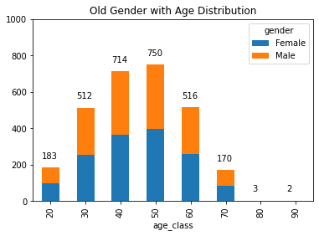
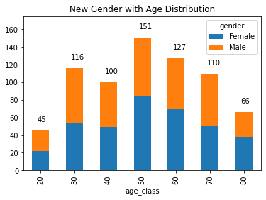
Data Exploration
Gender with Age distribution
As we can see, mostly our new customers are between 25 to 48 years old.
Number of customers from 48 to 59 years old has big drops on percentages.
There is a slightly increase in number of customers over 59 years old in term of percentages
It looks like the percentages of under 25 years old not really change.

Slide 6
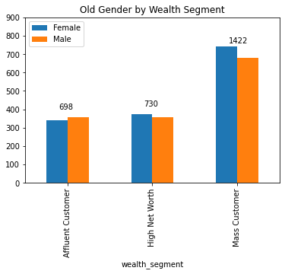
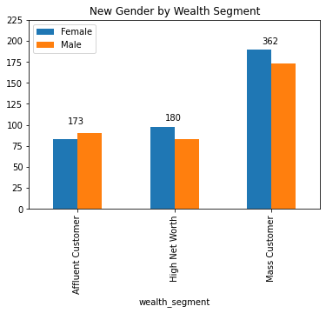
Gender with Wealth Segment

Slide 7
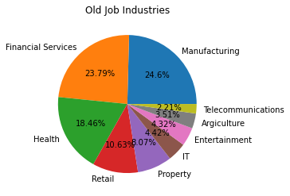
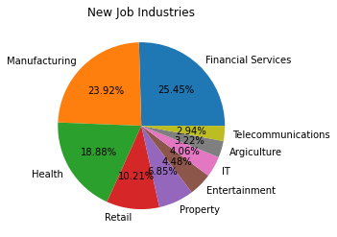
Job Industry Diversity

Slide 8
Model Development
RFM Analysis
Recency
The last day on which a customer performed a transaction was taken as the recency parameter.
Customers were divided into 4 quartiles and given a R_Score.
Frequency
The frequency of transactions done by a particular customer was taken as the frequency parameter.
Customers were divided into 4 quartiles and given a F_Score.
Monetary Value
The average profit per customer was taken as the monetary value parameter.
Customers were divided into 4 quartiles and given a M_Score.

Slide 9
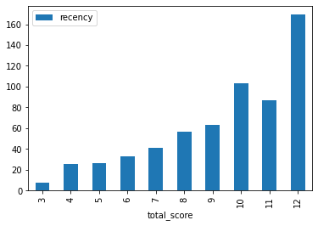
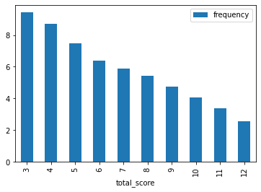
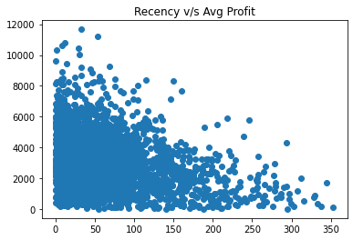
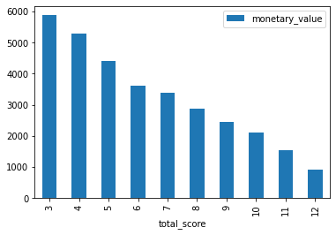
RFM Analysis

Slide 10
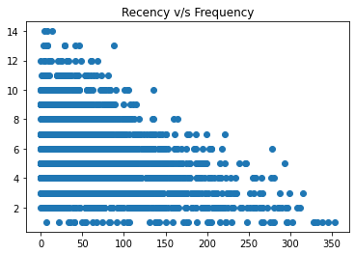
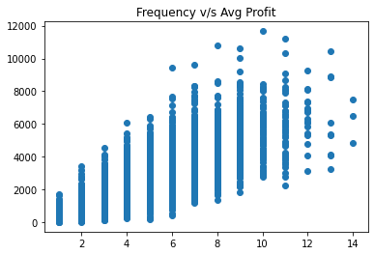
RFM Analysis

Slide 11
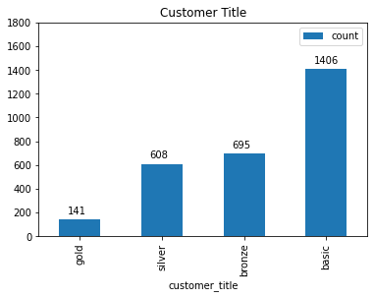
RFM Analysis
Based on the RFM Class, four customer tiers were identified:
Gold Class: These customers have recently made a purchase, are frequent and are most profitable.
Silver Class
Bronze Class
Basic Class: These customers have not made any recent purchase, are not frequent and do not contribute majorly.

Slide 12
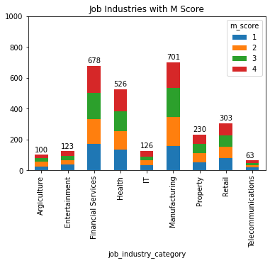
Interpretation
Job industry category
Mostly our new customers are on Finance industry and our Manufacturing customers are still on top 2.
The rest industries is still same

Slide 13
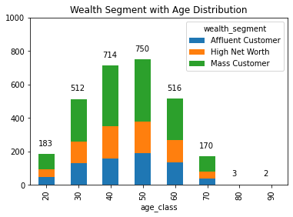
Wealth segments
In all ages, the number of Mass Customers is the highest so we should focus on this social class.
After that, we should focus on High Net Customer.
Then Affluent Customers but mostly second and third quadrant

Slide 14
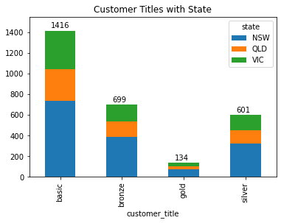
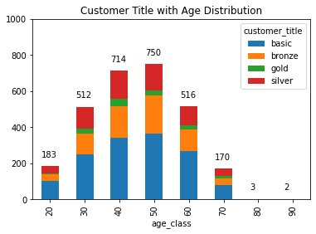
Customer Tiers by State and age distribution

Slide 15
Appendix

Slide 16
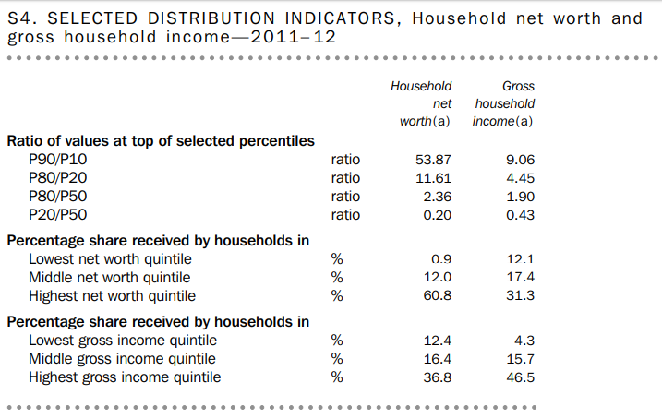
Appendix
Source: Australian Bureau of Statistics

Slide 17
Thank you

